Slide 1

DMart Inventory Optimization Case Study

Slide 2
Background:
In an increasingly competitive retail landscape, optimizing inventory balancing product availability against holding costs is critical for profitability. For my latest project, I performed a comparative case study on DMart’s sales data to uncover actionable insights for smarter stocking and stronger customer engagement.

Slide 3
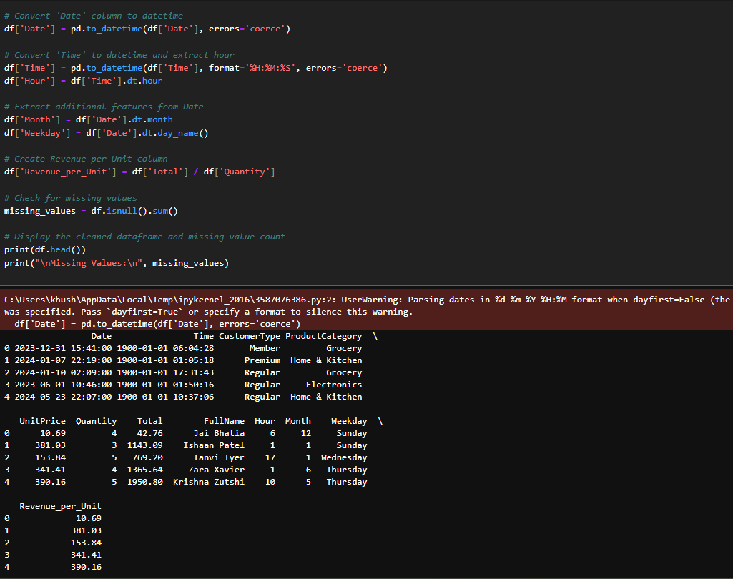
Project Overview:
Objective: Analyze DMart’s transaction data to optimize inventory
Timeline: Jan 2023 – Jan 2025
Dataset: 1M+ transactions
Tools: Python (Pandas, Seaborn), Power BI

Slide 4
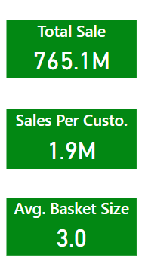
Key Metrics Summary:
Total Sales: ₹765.1 M
Avg Basket Size: 3.0 items
Avg Sales/Customer: ₹1.9 M
Highlight: Consistent daily sales (~₹1M)

Slide 5
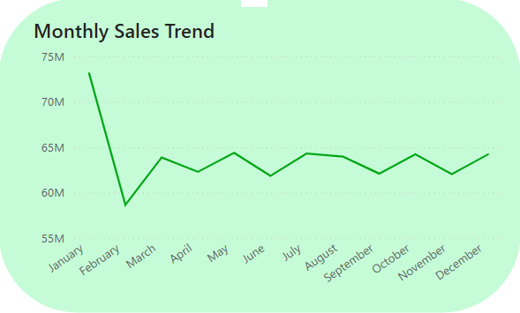
Monthly Sales Performance:
Line chart: Monthly sales from Jan 2023–Jan 2025
Peak: Jan 2023 (~₹73M)
Dip: Feb 2023 (~₹60M)
Insight: Seasonality patterns observed

Slide 6
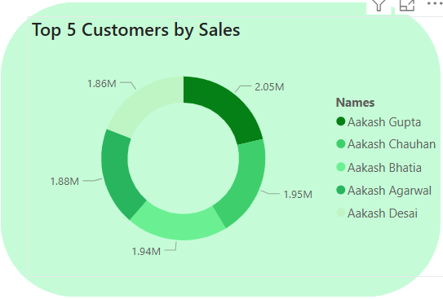
Customer Segment Analysis
Premium, Regular, Member → ~₹50M sales each/month
Top Customers (Pie Chart)
Aakash Gupta: ₹2.05M
Others: ₹1.86M–₹2.00M

Slide 7
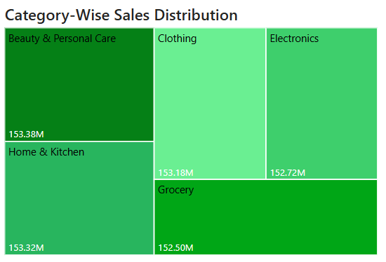
Product Category Performance
Treemap:
Beauty & Personal Care: ₹153.38M
Electronics: ₹152.72M
Home & Kitchen: ₹152.3M
Low-performers: Grocery, Clothing

Slide 8
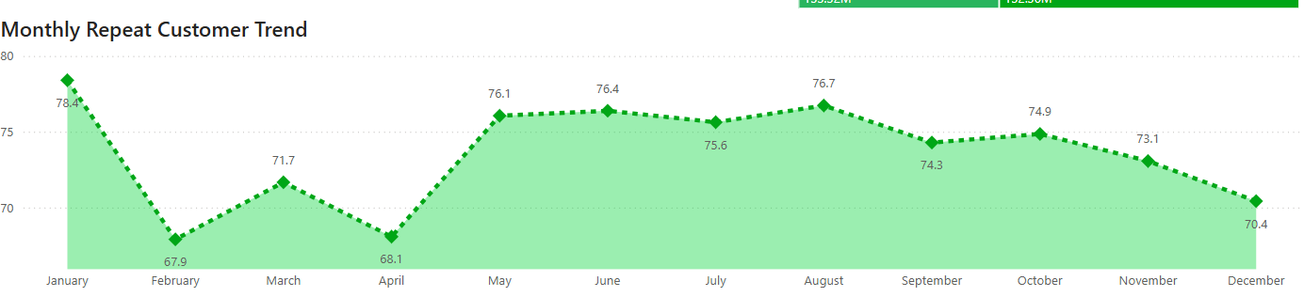
Repeat Customer Trends
Line Chart: Monthly repeat rate
Jan: 78.4%, Feb dip: 67.9%, Avg: ~72%
Insight: Stable base but needs retention push

Slide 9
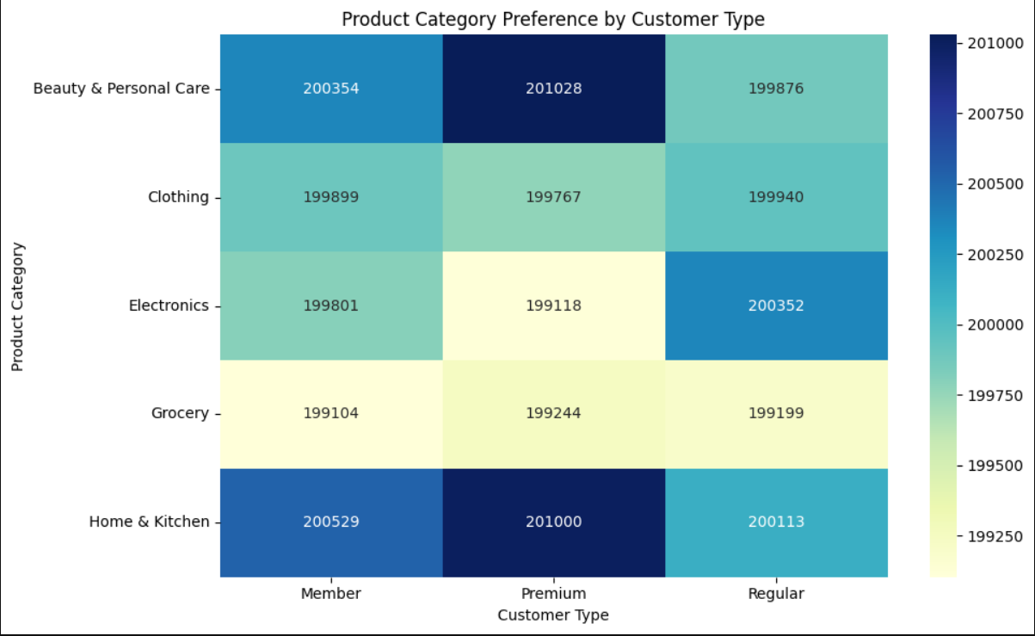
Segment-Category Heatmap
Regulars → Electronics
Premiums → Home & Kitchen, Beauty
Strategic fit for tailored campaigns

Slide 10
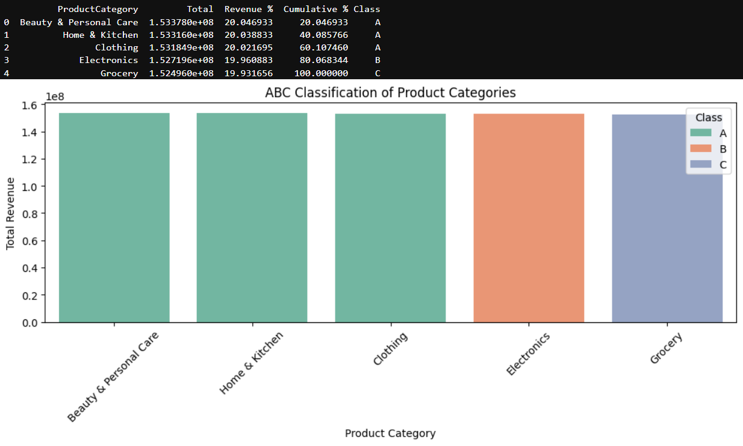
ABC Classification
Class A (Top 70%): Beauty, Home & Kitchen
Class B (Next 20%): Electronics
Class C (Last 10%): Grocery, Clothing
Strategy: Prioritize A for replenishment

Slide 11
Thank You

